Slide 1


Windows Auditing Tool
Dumpsec

Slide 2
What is Dumpsec
Classical Windows Host Based Auditing tools
Security auditing program for Microsoft Windows® NT/XP/200x
Lists the following
File permissions (DACLs)
Audit settings (SACLs) for the file system,
Registry, printers and shares
User
In a concise, readable format, so that holes in system security are readily apparent.

Slide 3
DumpSec
DumpSec also dumps or prints
User,
Group and
Replication information

Slide 4
Uses
Only generates Raw DATA !!
You as the Auditor or Security Analysis must interpret the results and data.

Slide 5
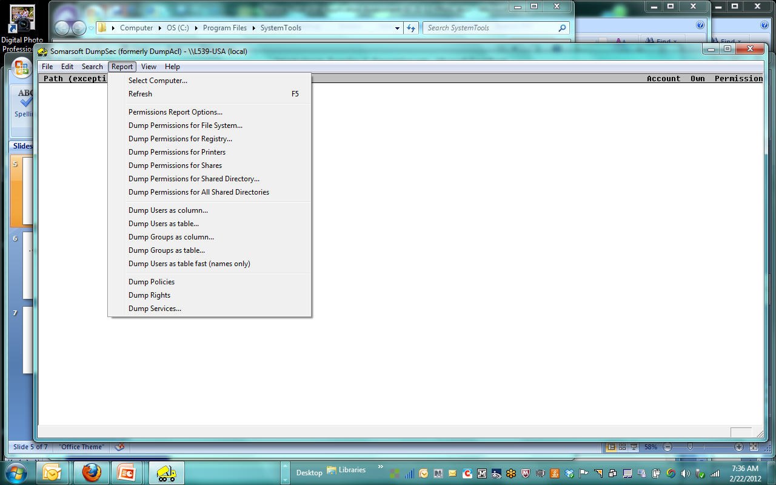
Initial Start-Up

Slide 6
Types of Report Data
Windows Security and Setting

Slide 7
Domain Policies
Password Policies
length
age
History
lock Out

Slide 8
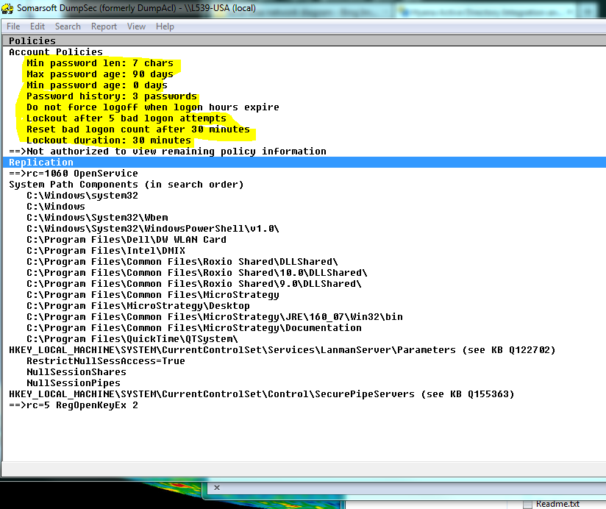
Domain Account Policies

Slide 9
User Account Data
Example of data generated
User Name
Last login
Acct Disabled
Acct Locket Out
Password Expired

Slide 10
Audit Tests:
Example of Tests
expired accounts that are not deactivated
User accounts that have not logged in for a period of time.
Segregation of Duties
Users that may have admin Privileges
Developers that may be in the incorrect Groups
Verifications of Account Policies to the organizations Security Policies
Password
Auditing

Slide 11
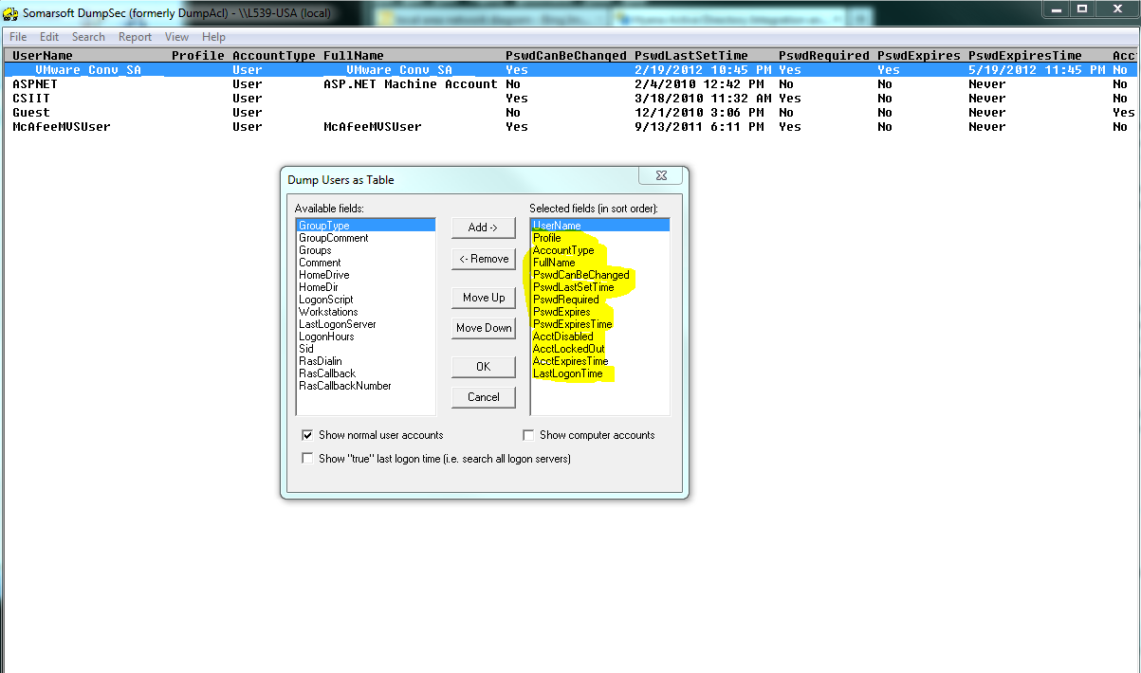
User Data

Slide 12
Recap
Use as an independent tool to obtain Windows auditing information.
You must evaluate the results
Try to get the system administrator to execute the tool for you.

Slide 13
Lab
Examine the attached Spreadsheet and perform the following tests
Expired users
Accounts that Should Be Disabled
Potential Segregation of Duties Problems
Users with excessive privileges.

Slide 14



www.controlsolutions.com

